Slide 1

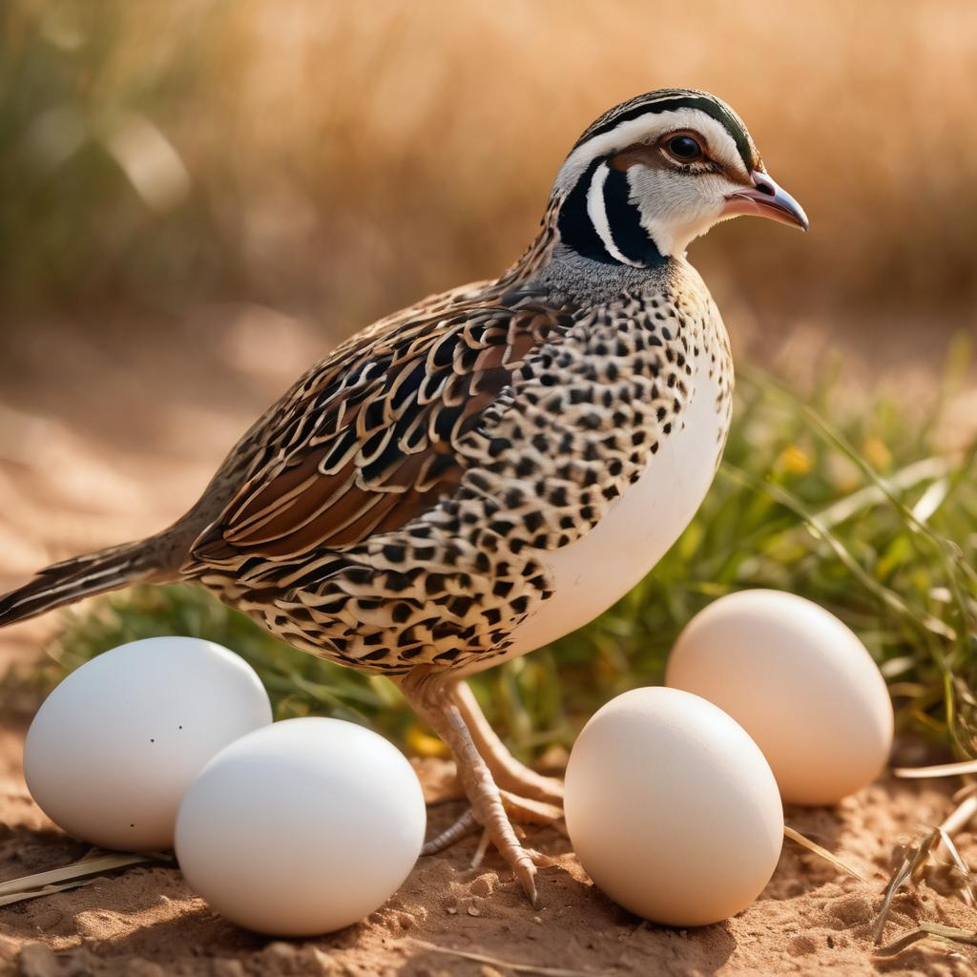
BEDANA
FARM
WEBSITE
Department: Computer Engineering
Student’s full name: Jahongir Marksov
Student’s number: 1903010068
Supervisor: Prof. Dr. Mostafa Ayoubi Mobarhan
2024 January 25

Slide 2
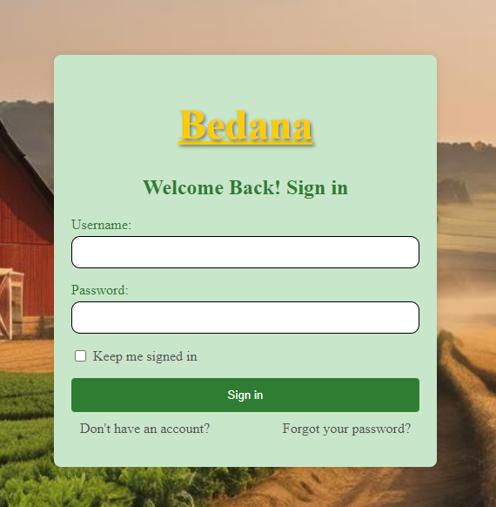
BEDANA
Welcome to the beauty of nature, where fresh and nutritious eggs are produced.
Mission and Vision of Bedana Farm
Overview of the website
Login page explanation

Slide 3
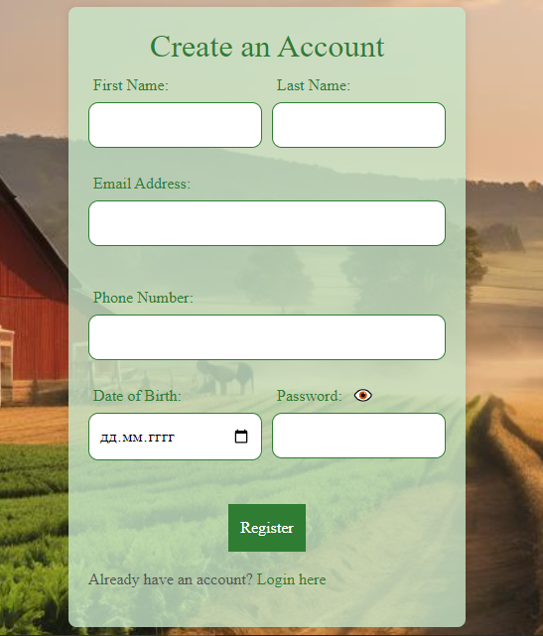
REGISTARTION PAGE
Importance of registration page
Essential form fields
Key features

Slide 4
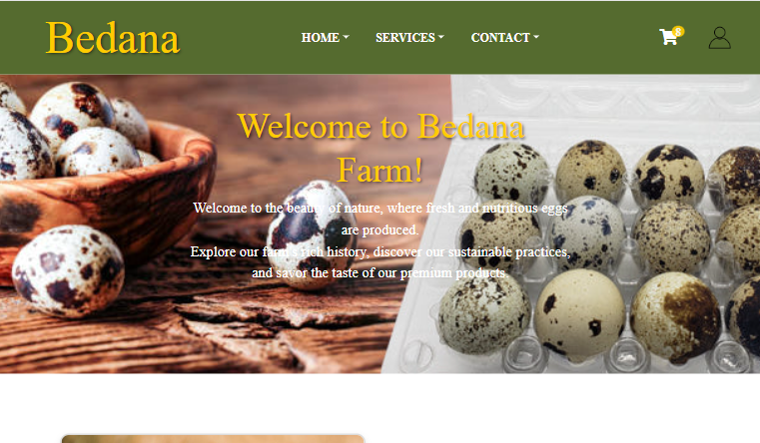
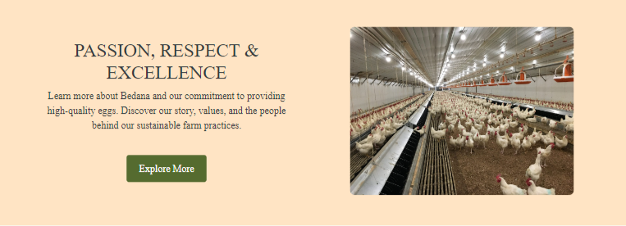
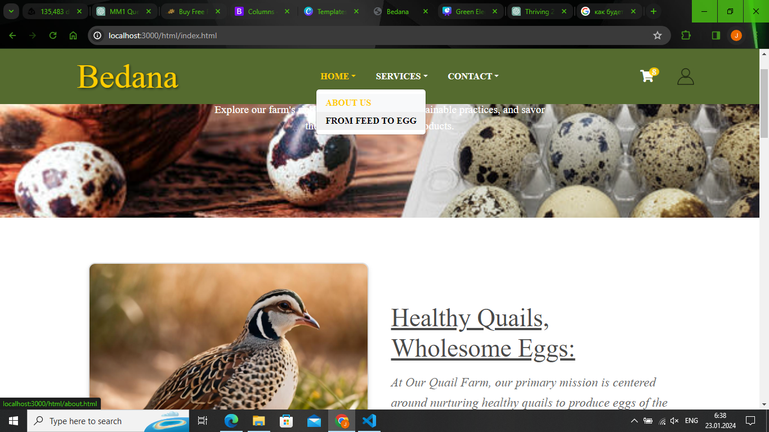
LANDING PAGE
homepage as the gateway to Bedana Farm
impactful image and welcoming message
top navigation bar
carefully chosen color scheme and font for a pleasant visual
interactive features

Slide 5
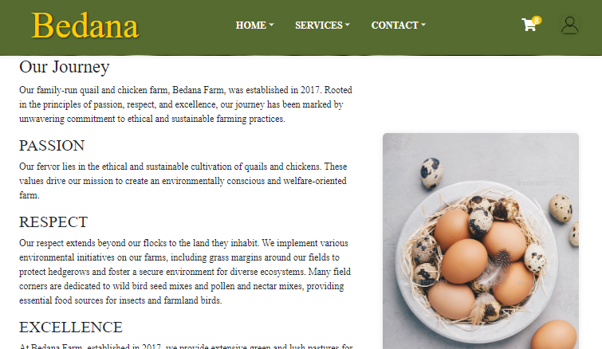
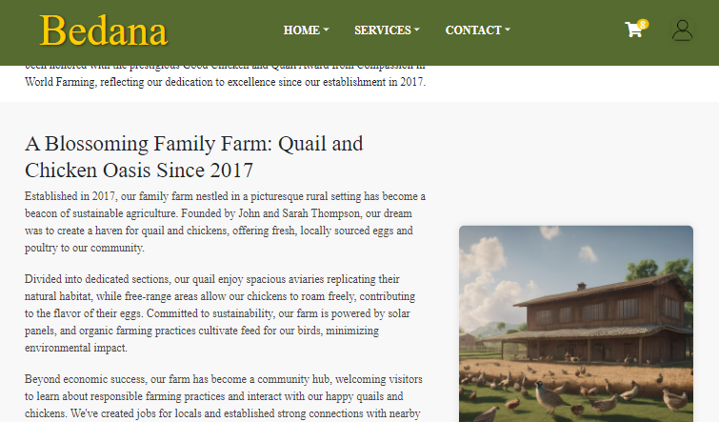

ABOUT US
Farm’s origin and history
farm’s mission and core values
unique or innovative features
farm's vision and projects for the future
Best Quality
fresh eggs
eco-friendly
Good Product

Slide 6
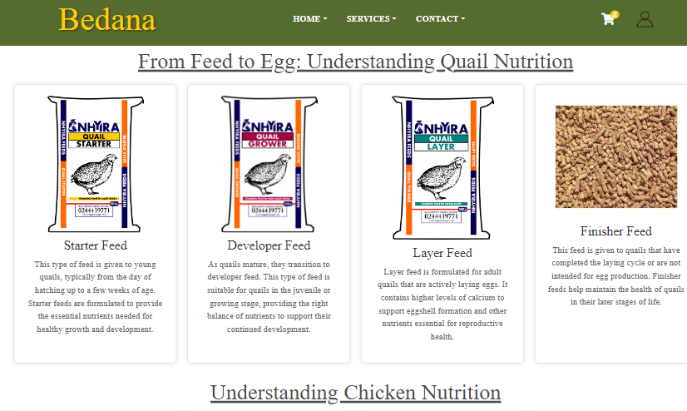
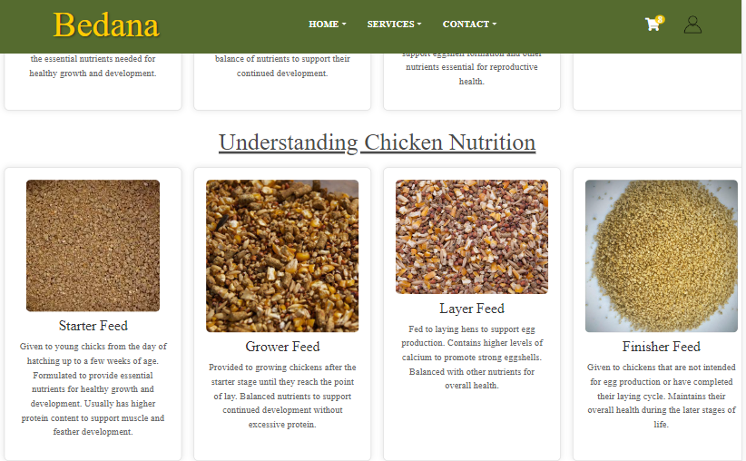
FROM FEED TO EGG
importance of the "Feed to Egg" process
egg collection and handling procedures
farm's approach to producing high-quality egg
freshness and quality control measures

Slide 7
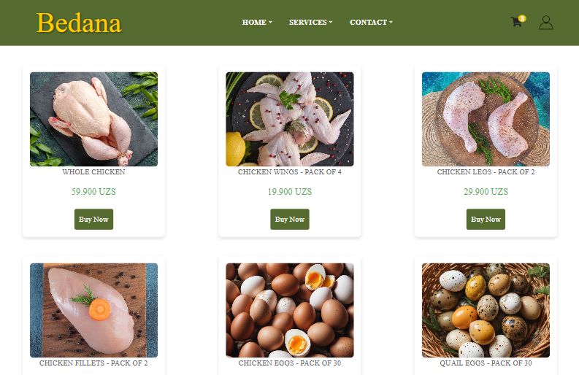
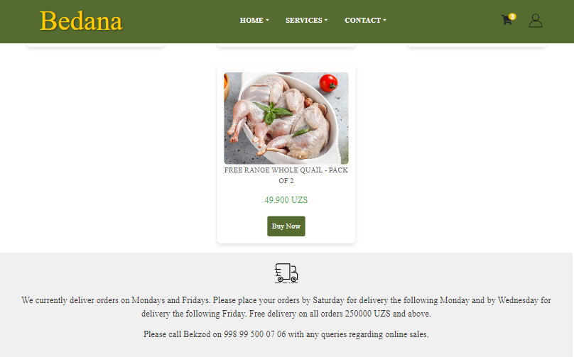
BUY NOW
variety of products available for purchase
information on the delivery process and customer support
images and brief descriptions
"Buy Now" page and Basket page connection

Slide 8
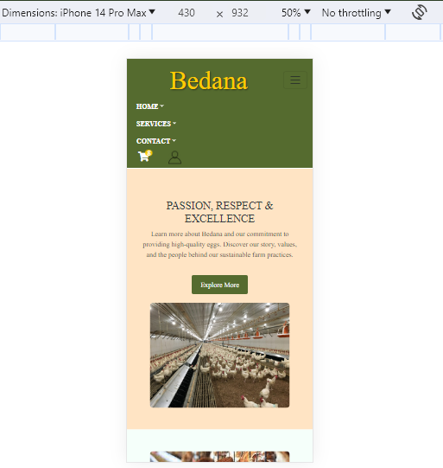
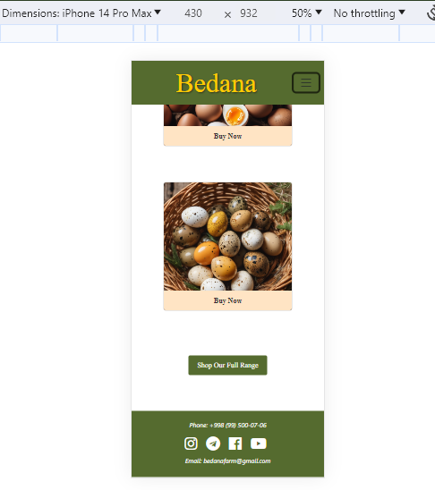
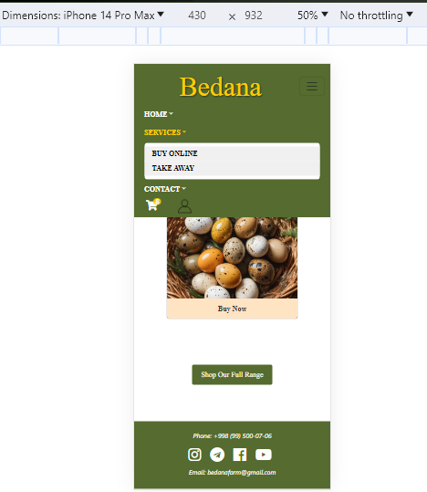
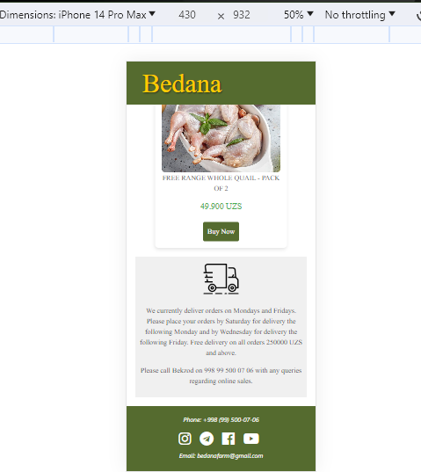
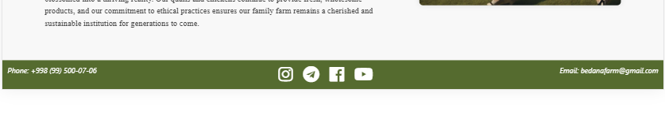
RESPONSIVE

Slide 9
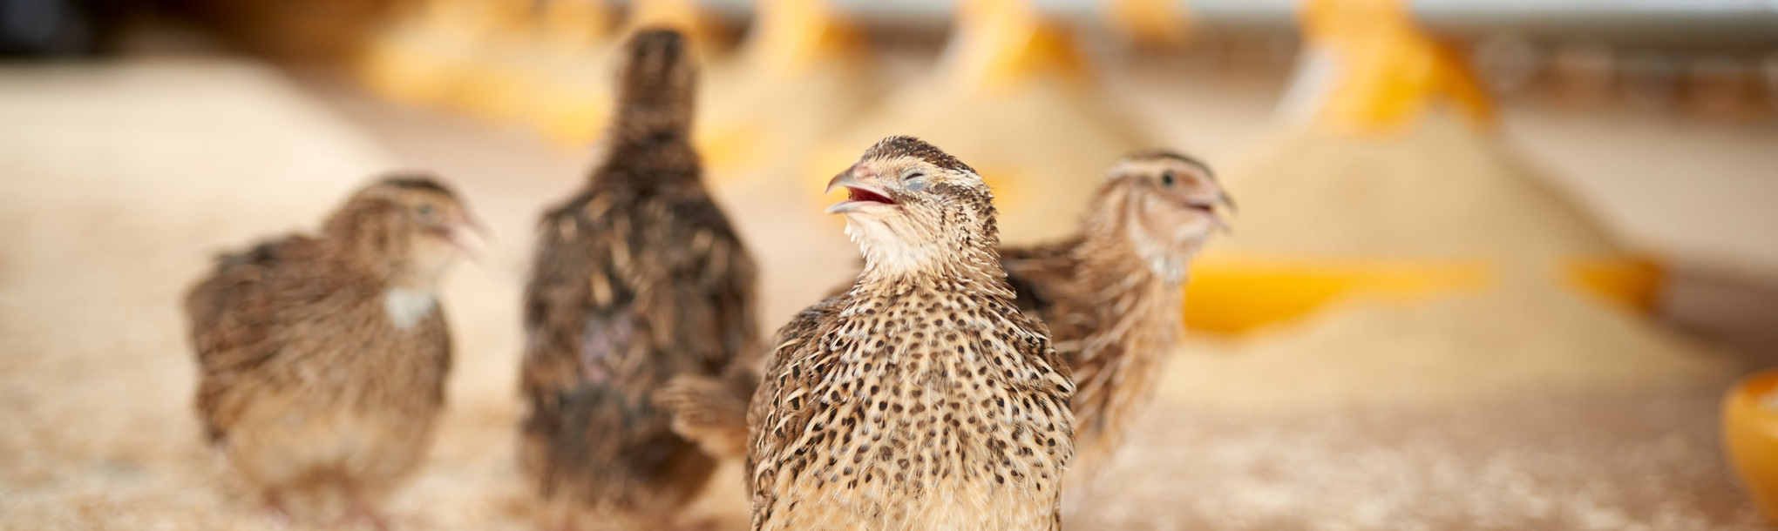
WHAT’S NEXT?
to create a basket_info page
to build backend of login and registration pages
to create full functional basket
to create a feedback page

Slide 10

THANKS FOR
Your Attention

